Slide 1



Thematic Dossier
Financial Access to Education: What are the Conditions for Student Success?
Notes:
Page titre

Slide 2


Note that it is permitted to copy, share and modify this presentation for non-commercial purposes, provided that the mention “Observatoire sur la réussite en enseignement supérieur, 2023” appears and that the conditions for sharing are the same as those that pertain to this presentation.
Creative Commons BY-NC-SA 4.0
This document was produced with the financial support of the Gouvernement du Québec, under the Canada-Québec Agreement.
Observatoire sur la réussite en enseignement supérieur | 2023

Slide 3

This presentation outlines the main findings of the Observatoire sur la réussite en enseignement supérieur concerning the thematic dossier entitled “Financial Access to Education: What are the Conditions for Student Success?”.
You can use it to provide highlights from this dossier and initiate a team reflection on the subject. You can also use it to raise awareness among your colleagues to commit to collective action on these issues.
Observatoire sur la réussite en enseignement supérieur | 2023

Slide 4



ORES
Our mandate is to share with higher education stakeholders the most reliable and relevant scientific and experiential knowledge on student success.
oresquebec.ca

Slide 5






Presentation Outline
Background
Issues at Skate
Key Concepts
Prospectives
Inspiring Practices
Tools and Activities

Slide 6

Background
Accessible Education for All

Slide 7


Background
Accessible Education for All
  Québec’s student financial assistance (SFA) program aims to break down financial barriers and inequalities of opportunity.
(Bouchard St-Amant, 2020; Colas & al., 2021)
  Although tuition fees have been frozen several times over the years under the SFA program, there is now a consensus that they should be indexed to inflation.
  (Beaupré-Lavallée & Bégin-Caouette, 2019)
Observatoire sur la réussite en enseignement supérieur | 2023
Image : The Gender Spectrum Collection
Observatoire sur la réussite en enseignement supérieur | 2023

Slide 8

Background
Accessible Education for All
  Inflation has been rising sharply in recent years
(Statistics Canada, 2023)
  The impact of inflation is uneven, affecting some students more than others
(Bottorff & al., 2020; Savoie-Roskos & al., 2023)
Observatoire sur la réussite en enseignement supérieur | 2023
Image : The Gender Spectrum Collection
Observatoire sur la réussite en enseignement supérieur | 2023

Slide 9
Issues at Skates
Conditions for Success

Slide 10
Issues at Skate
Conditions for Success
Eating, a Condition for Success
Toward an Updated and All-Encompassing Student Financial Assistance Program
Housing, a Condition for Success
Student Remuneration in Line with Studies
Observatoire sur la réussite en enseignement supérieur | 2023

Slide 11



Eating, a Condition for Success
  Food insecurity causes stress and psychological distress for students who suffer from it.
  As a result, they are less likely to obtain a university degree.
Observatoire sur la réussite en enseignement supérieur | 2023

Slide 12



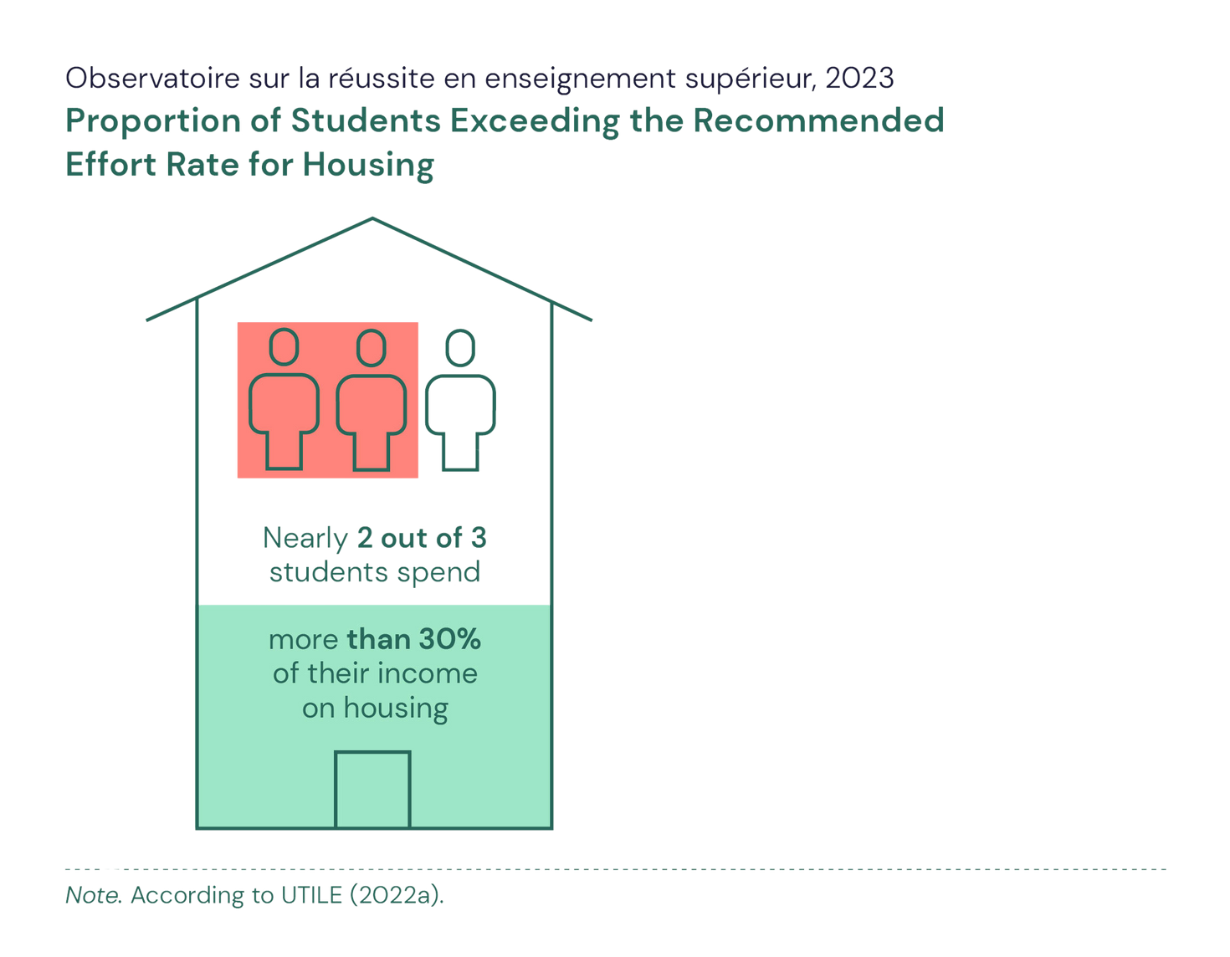
Housing, a Condition for Success
  The current affordable housing crisis is exacerbating students’ financial insecurity. It is a barrier to further study and threatens access to higher education.
  The international student population, particularly students from visible minorities, is more vulnerable to the difficulties of finding low-cost housing close to campus.
Observatoire sur la réussite en enseignement supérieur | 2023

Slide 13


Toward an Updated and All-Encompassing Student Financial Assistance Program
  Québec’s student financial assistance program is a key factor in increasing access to higher education and reducing financial insecurity among students.
  It should take into account the diversity of student populations and the new realities of the work-study balance.
Observatoire sur la réussite en enseignement supérieur | 2023

Slide 14
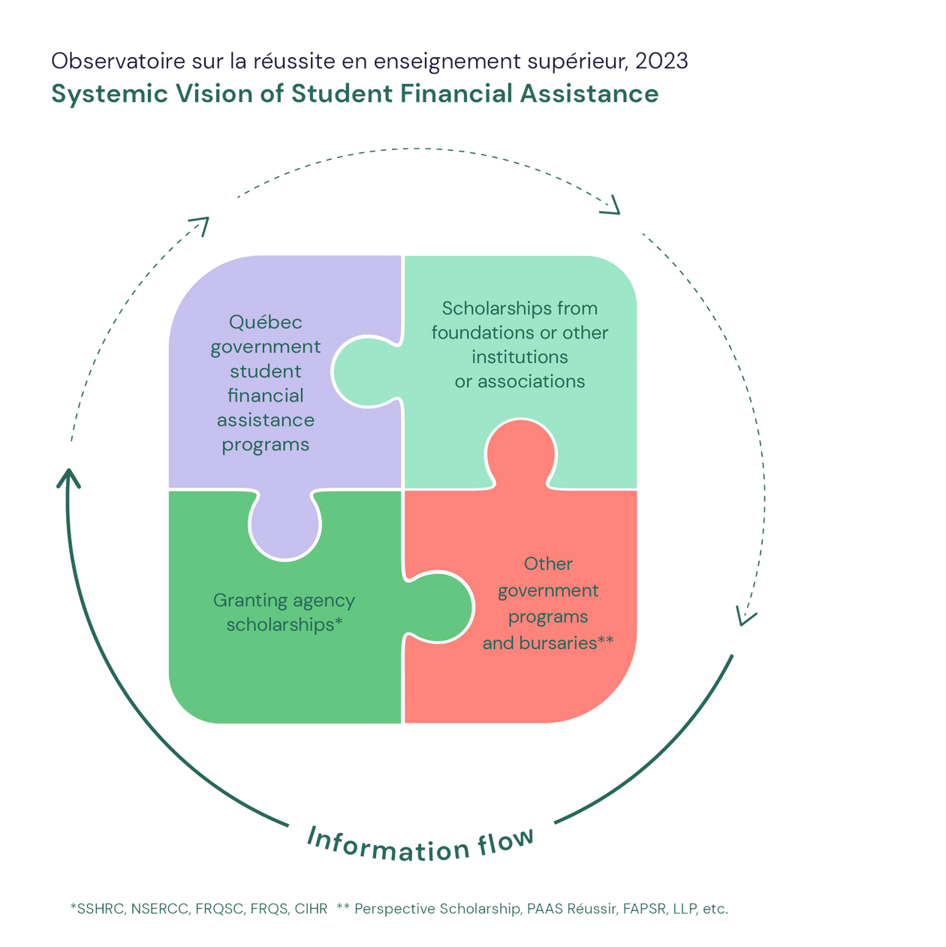
  A systemic vision of SFA implies the need for concerted action by the parties involved and better coordination between the various financial assistance programs.
*CRSH, CRSNG, FRQNT, FRQS, IRSC
** Bourses Perspectives, PAAS Réussir, PAFFARC, REEP, etc.
Observatoire sur la réussite en enseignement supérieur | 2023

Slide 15


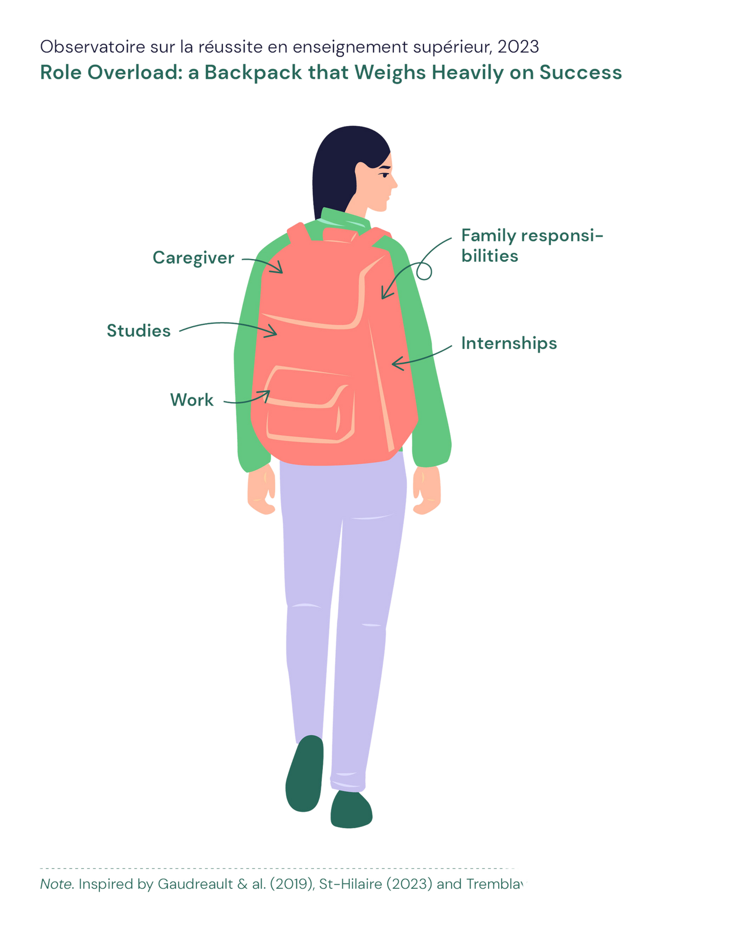
Student Remuneration in Line with Studies
  Contributes to success if it is related to one’s field of study and does not exceed a certain number of hours.
  Remuneration or compensation for internships reduces financial stress on students
Observatoire sur la réussite en enseignement supérieur | 2023

Slide 16

Key Concepts
Food Insecurity and Student Debt

Slide 17
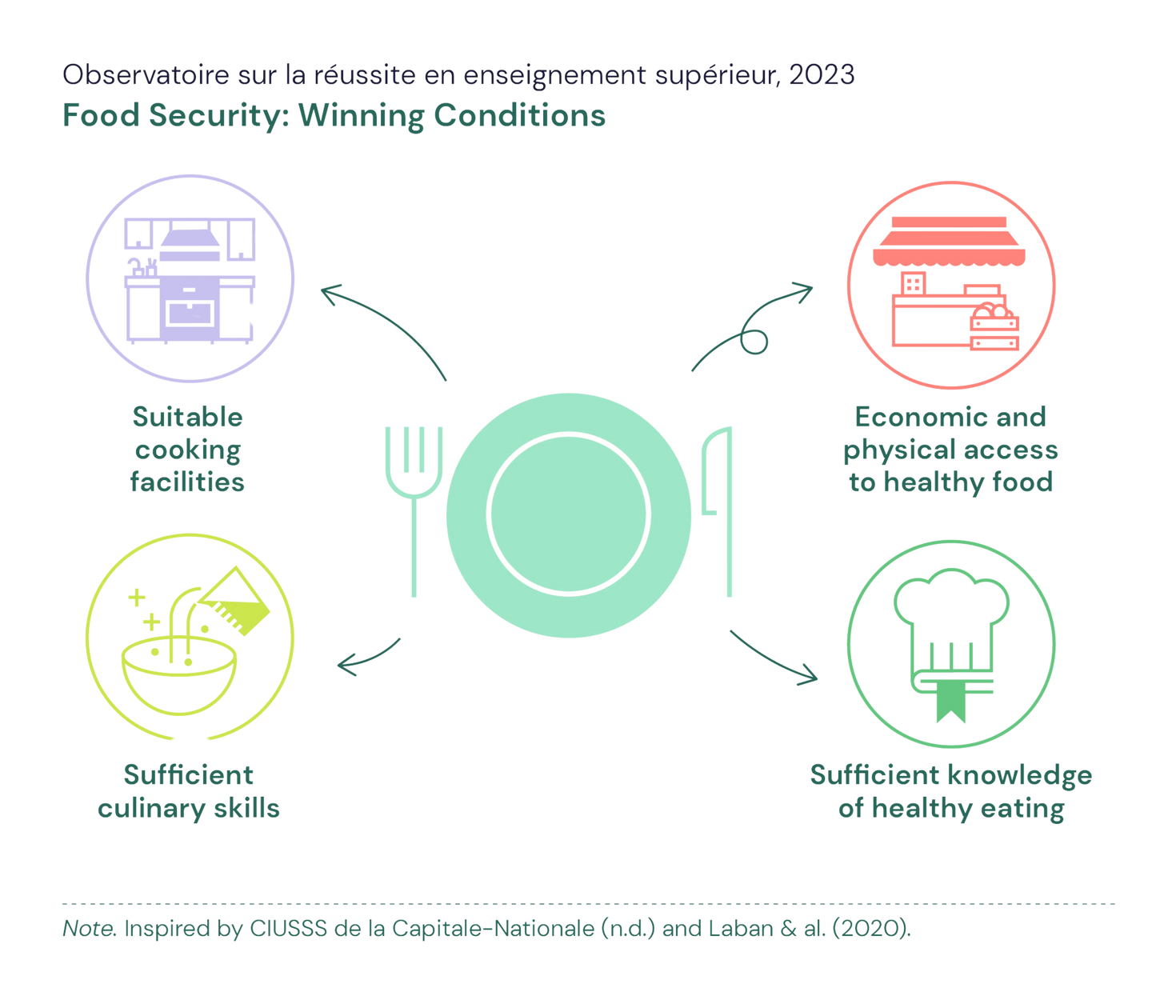
Notion clé
Key Concepts
Food Insecurity
Observatoire sur la réussite en enseignement supérieur | 2023

Slide 18
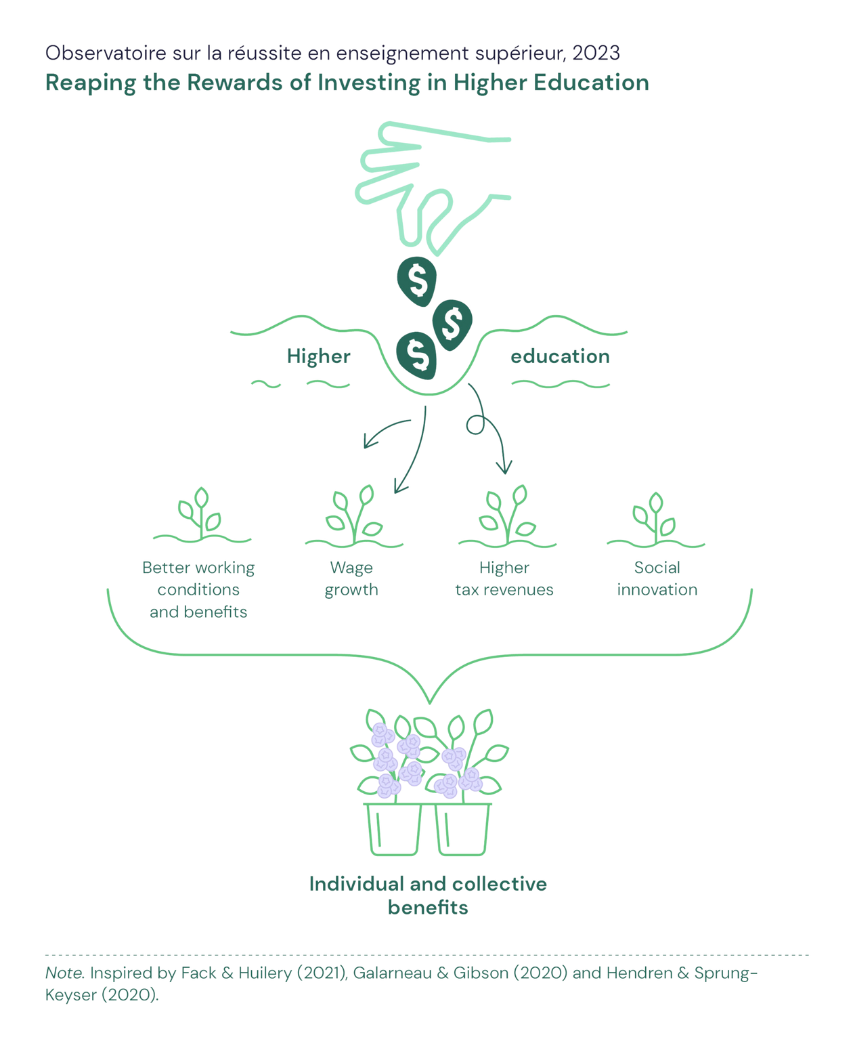
Key Concepts
Student Debt
L’endettement étudiant
  A distinction must be made between consumer credit debt and student debt from government loans.
  Investing in education would, in the long term, be “worth” the immediate costs associated with pursuing higher education (Johnson & al., 2016).
Observatoire sur la réussite en enseignement supérieur | 2023

Slide 19

Prospectives
Toward Student Financial Literacy

Slide 20

Prospectives
Toward Student Financial Literacy
  Financial education for students needs to be rooted in today’s student reality.
  Financial literacy programs aim to develop financial and overall student well-being, with a view to fostering success.
Observatoire sur la réussite en enseignement supérieur | 2023
Observatoire sur la réussite en enseignement supérieur | 2023

Slide 21
Inspiring Practices

Slide 22

Inspiring Practices
The AGORAé network in France
A meeting place created “by and for” the student community to promote food security on campus
Observatoire sur la réussite en enseignement supérieur | 2023
Observatoire sur la réussite en enseignement supérieur | 2023

Slide 23

Inspiring Practices
BCcampus Open Education
A project to create and distribute free textbooks to reduce the cost of books and course notes
Observatoire sur la réussite en enseignement supérieur | 2023
Observatoire sur la réussite en enseignement supérieur | 2023

Slide 24

Tools and Activities

Slide 25
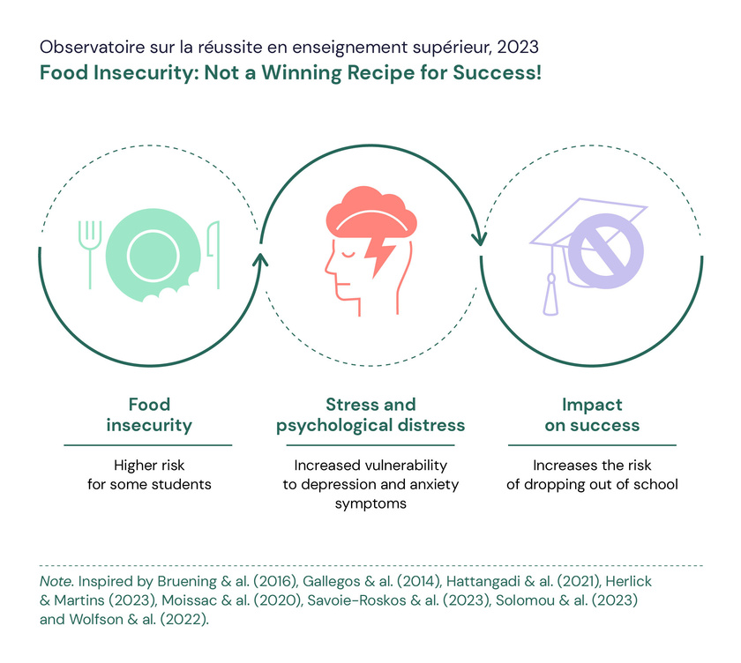
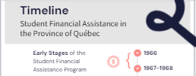
Tools
Activities
  Timeline of student financial assistance in the province of Québec
  Highlights infographic
  Information sheets on the courses of action for each issue
  Comic strip on the impact of financial stress on studies (coming in winter 2024)
  Illustration of the particularities experienced by graduate students (coming in winter 2024)
  Webinar on student debt and financial literacy) (November 20, 2023)
  Mobilization activity (coming in winter 2024)
Observatoire sur la réussite en enseignement supérieur | 2023

Slide 26


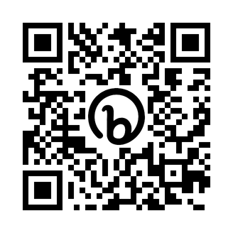


See the complete dossier
Subscribe to our newsletter
Follow us
Notes:
Page titre

